Slide 1
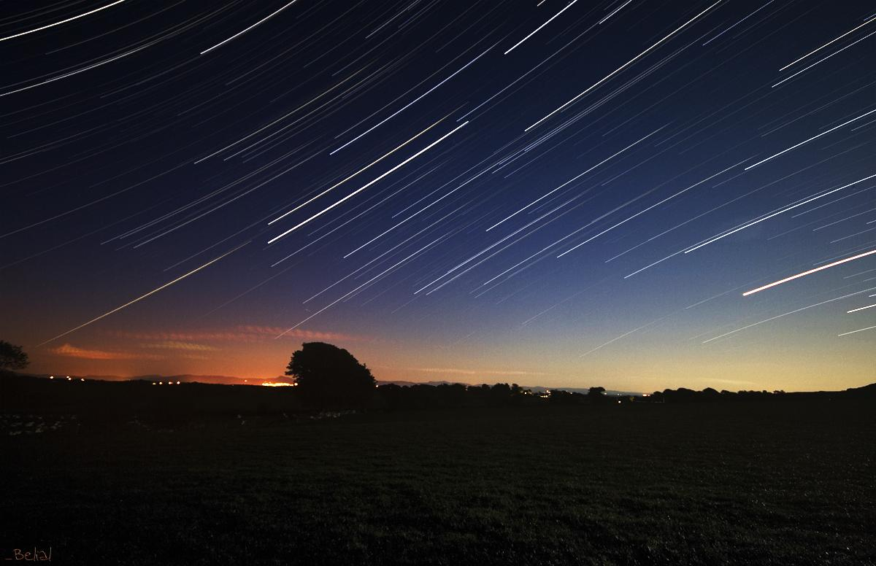
UbiZen
http://www.flickr.com/photos/17149966@N00/521278577/
Games Edition
Estudos em Jogos Ubíquos
Por Fabricio Nogueira Buzeto
www.unbiquitous.org

Slide 2
Ubicomp

Slide 3
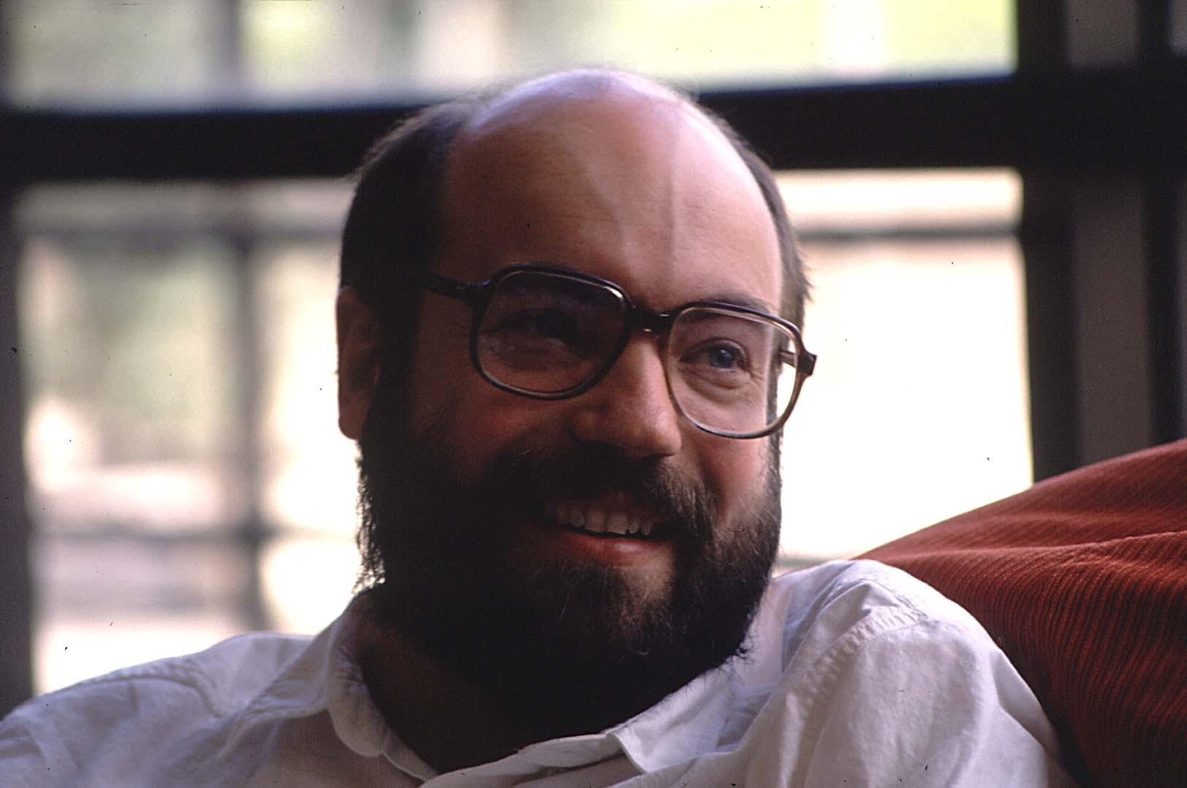
Mark
Weiser

Slide 4
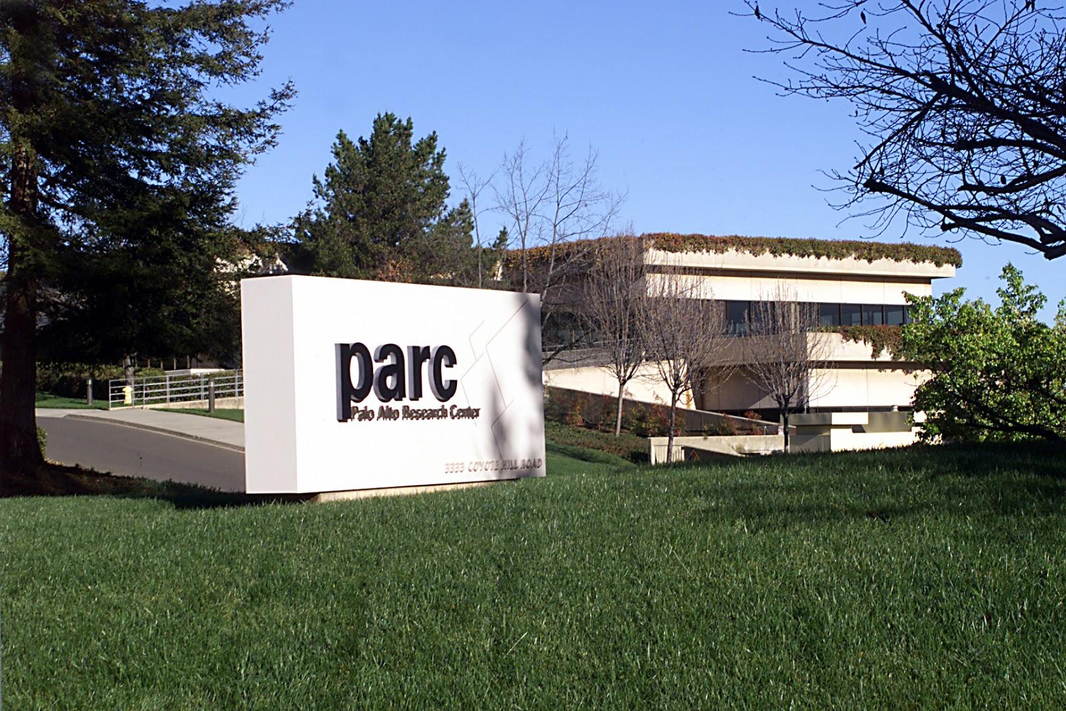

Slide 5
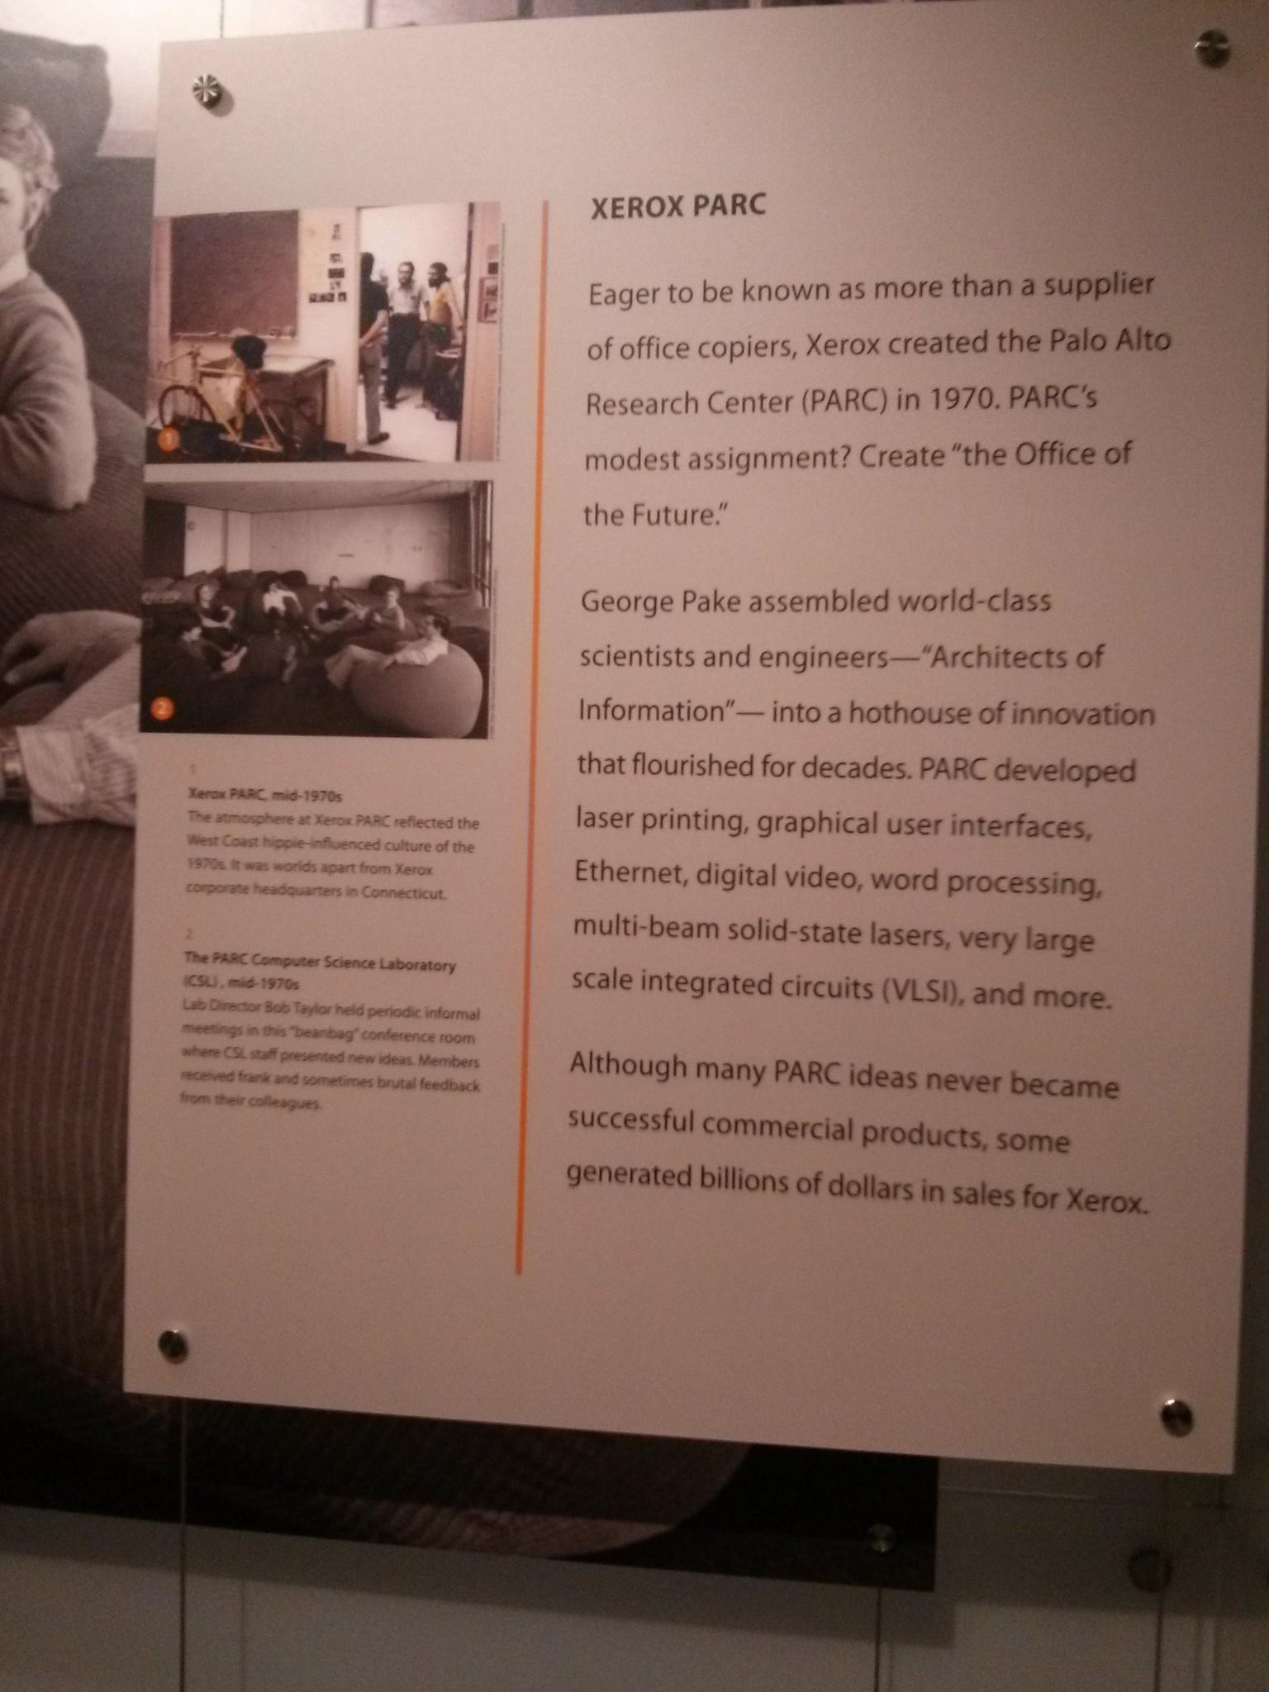

Slide 6
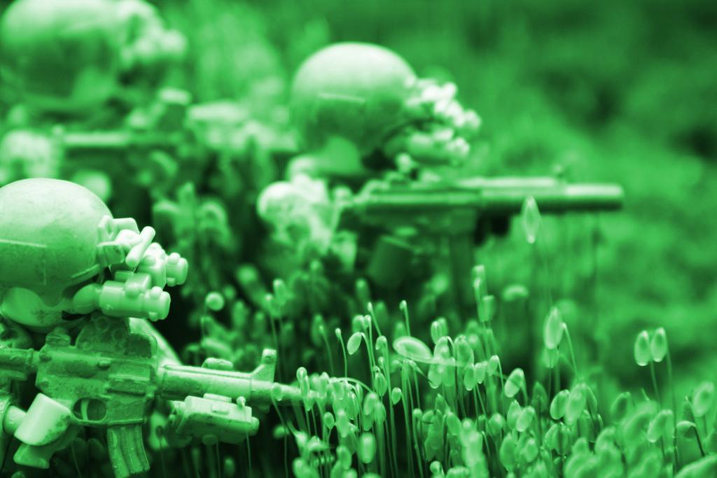
Visão
"http://www.flickr.com/photos/43322231@N07/5589147122/

Slide 7
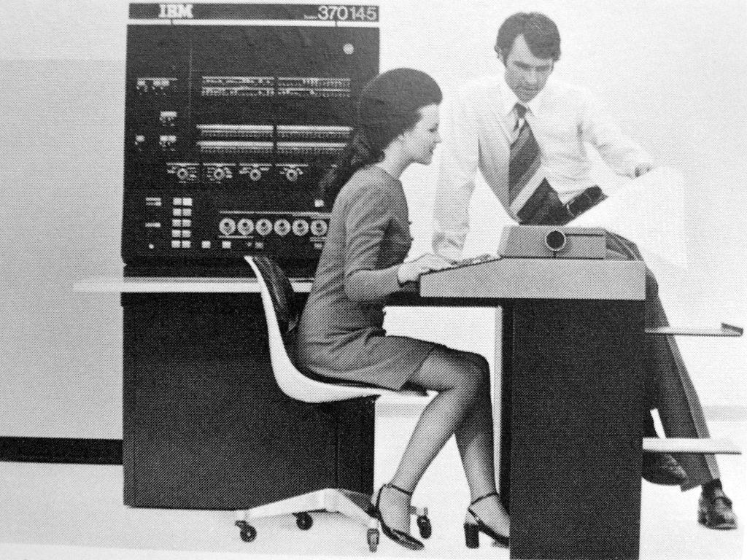
Mainframe
http://www.flickr.com/photos/49503078599@N01/10227059/

Slide 8
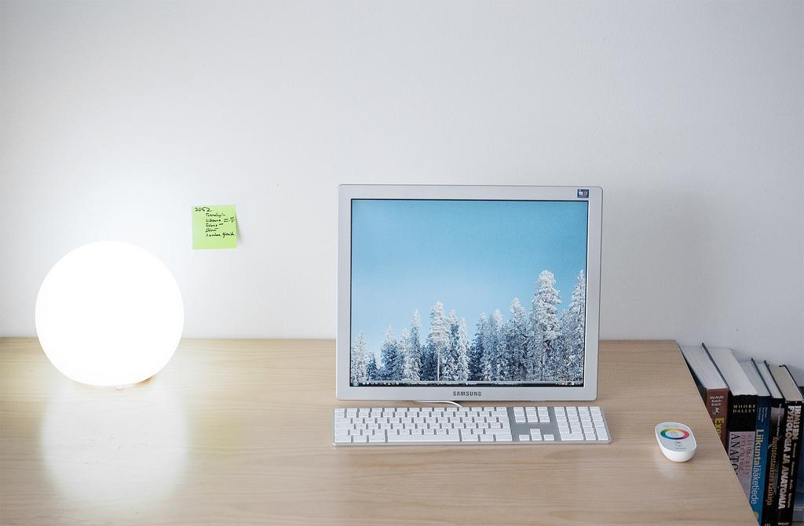
PC
http://www.flickr.com/photos/7294103@N03/3383924434/

Slide 9
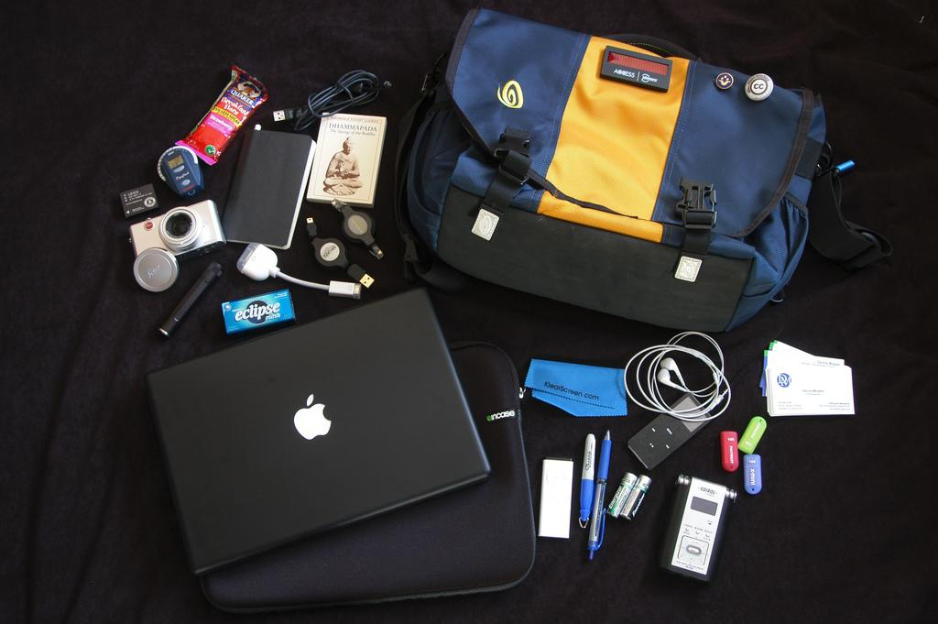
Ubicomp
http://www.flickr.com/photos/51486173@N00/240025839/

Slide 10
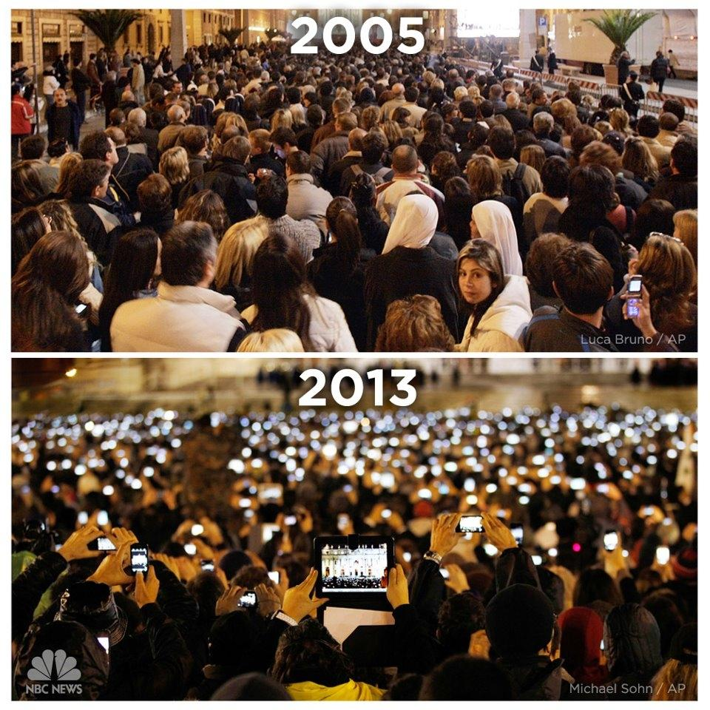

Slide 11



Slide 15
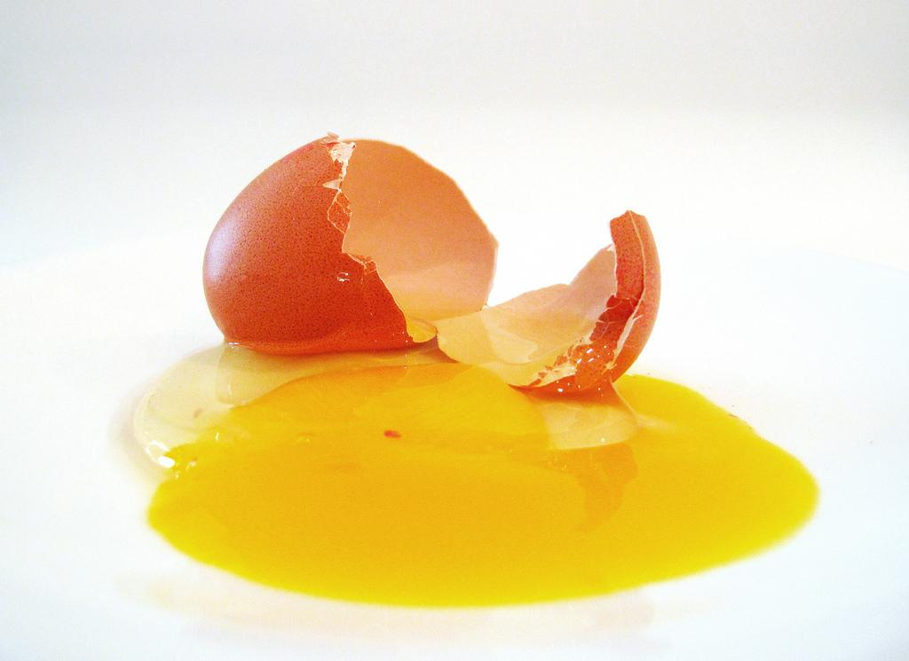
Nascimento
http://www.flickr.com/photos/64196871@N00/4998726126/

Slide 16
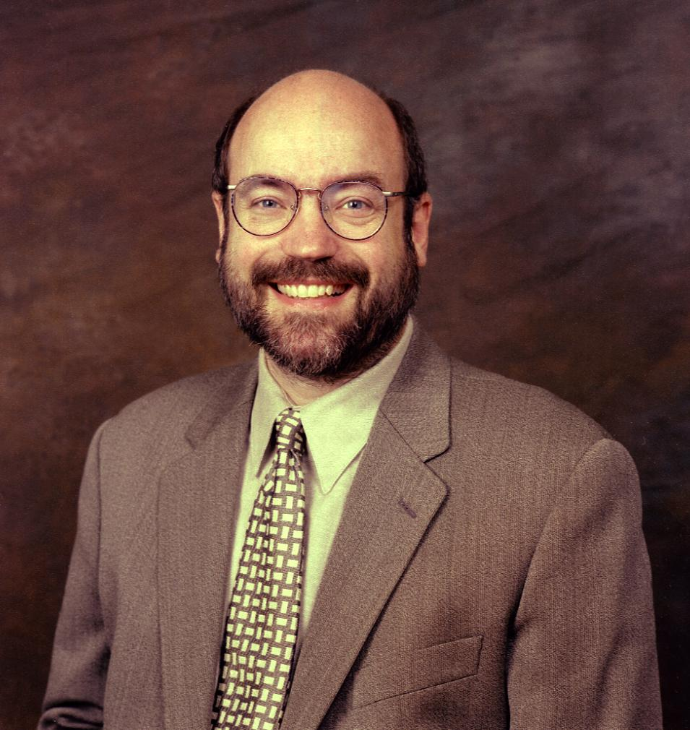
"The most profound technologies are those that disapear. They weave
themselves into
the fabric of
everyday life until
they are
indistinguishable
from it"

Slide 17
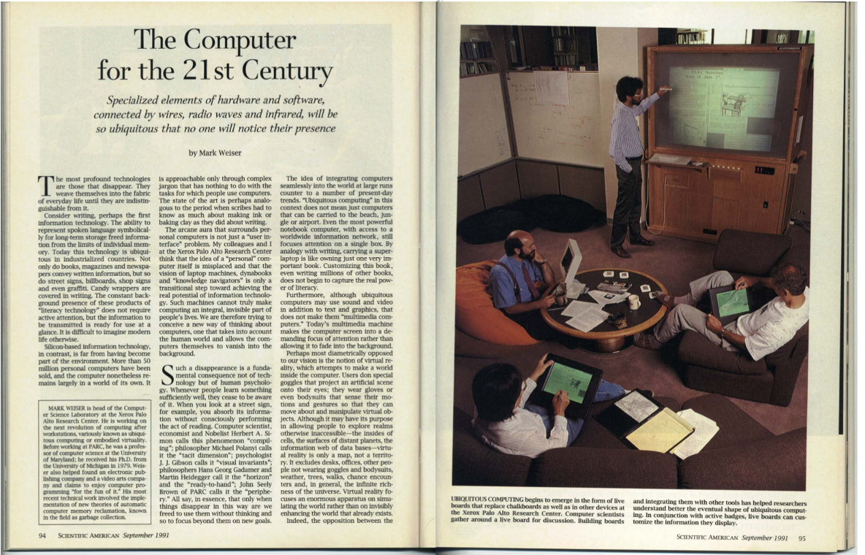

Slide 18
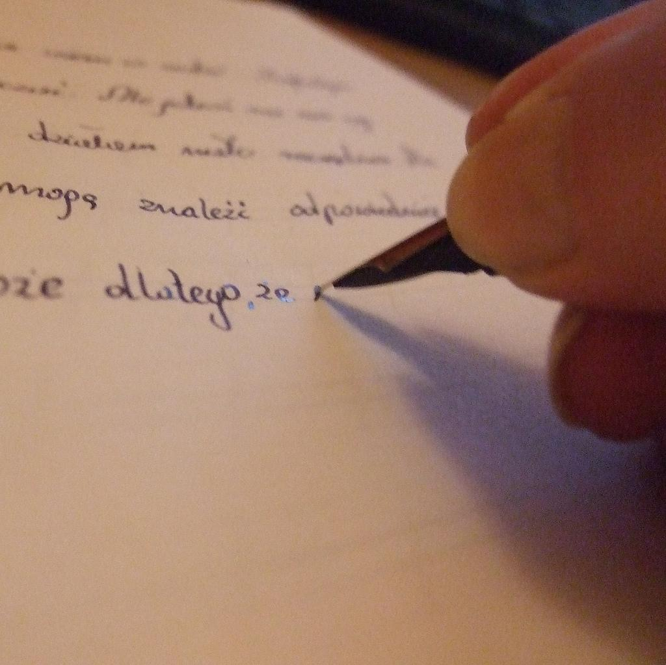
Escrita
"http://www.flickr.com/photos/31918365@N00/4100582240/

Slide 19
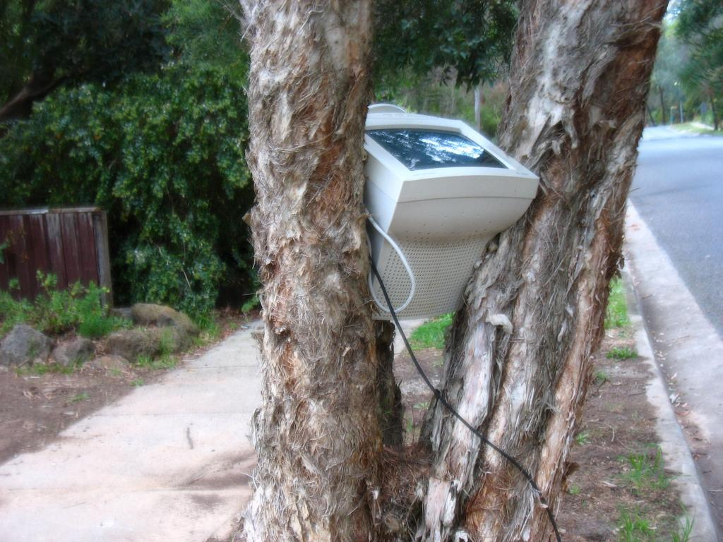
Computação
http://www.flickr.com/photos/orinrobertjohn/

Slide 20
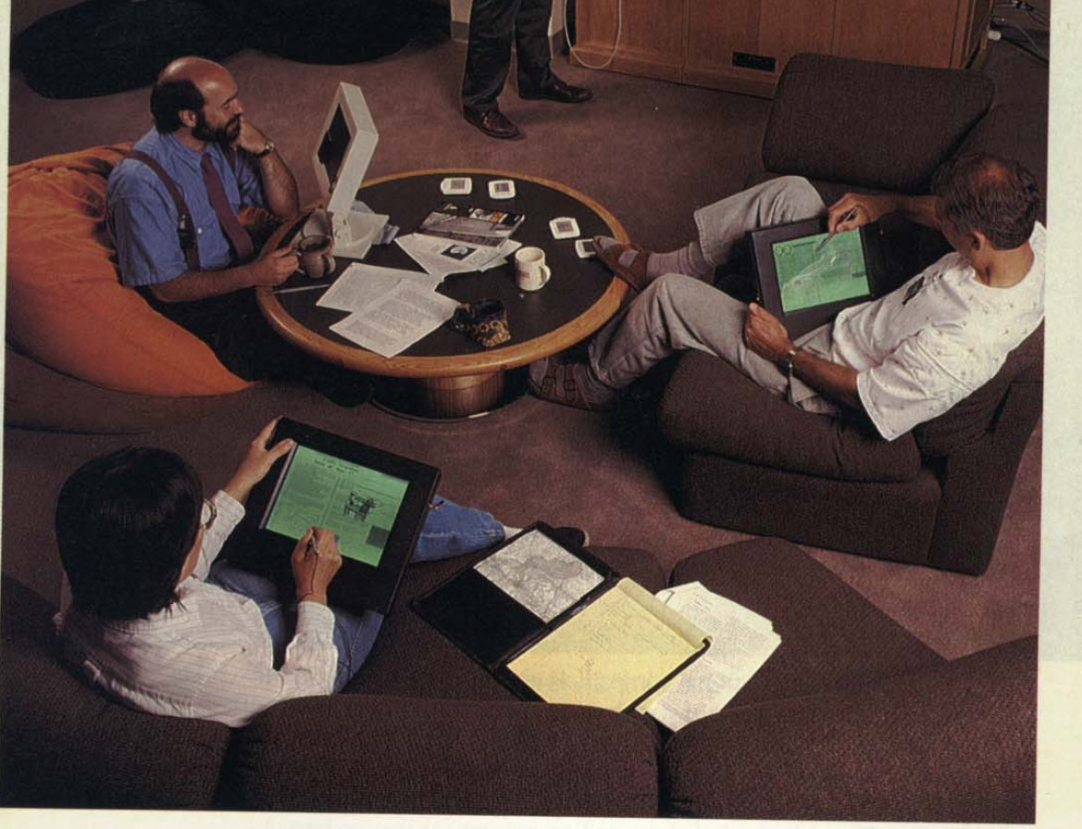

Slide 21
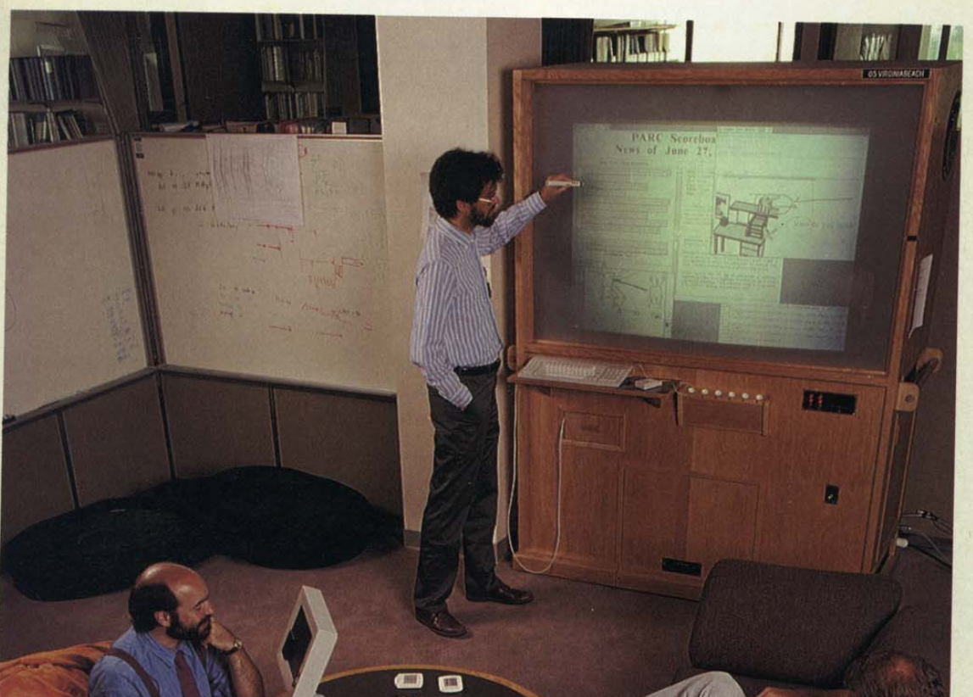

Slide 22
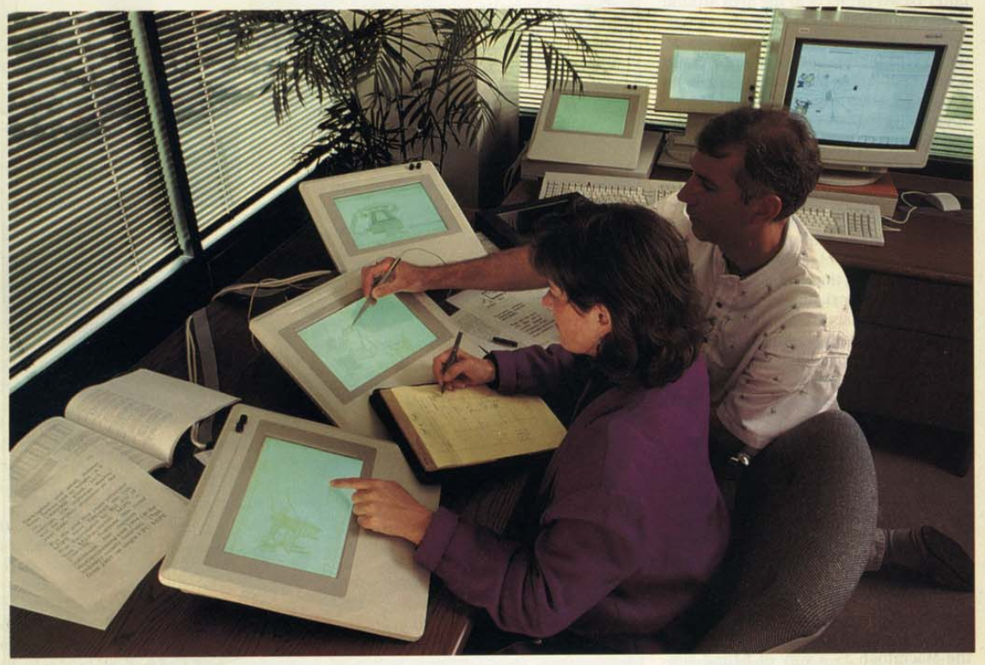

Slide 23
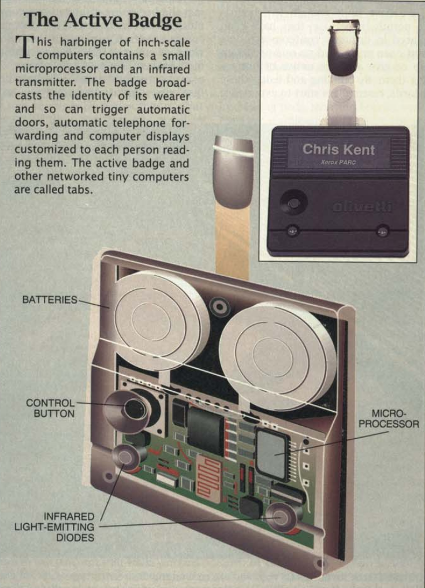


Slide 24
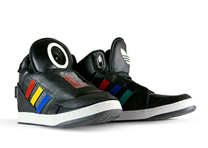
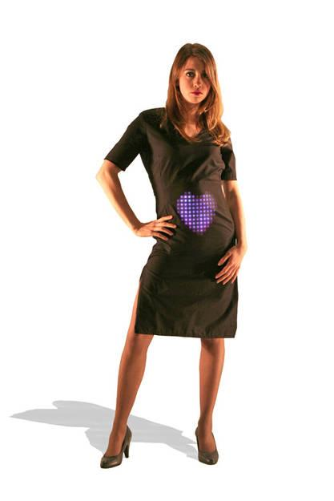
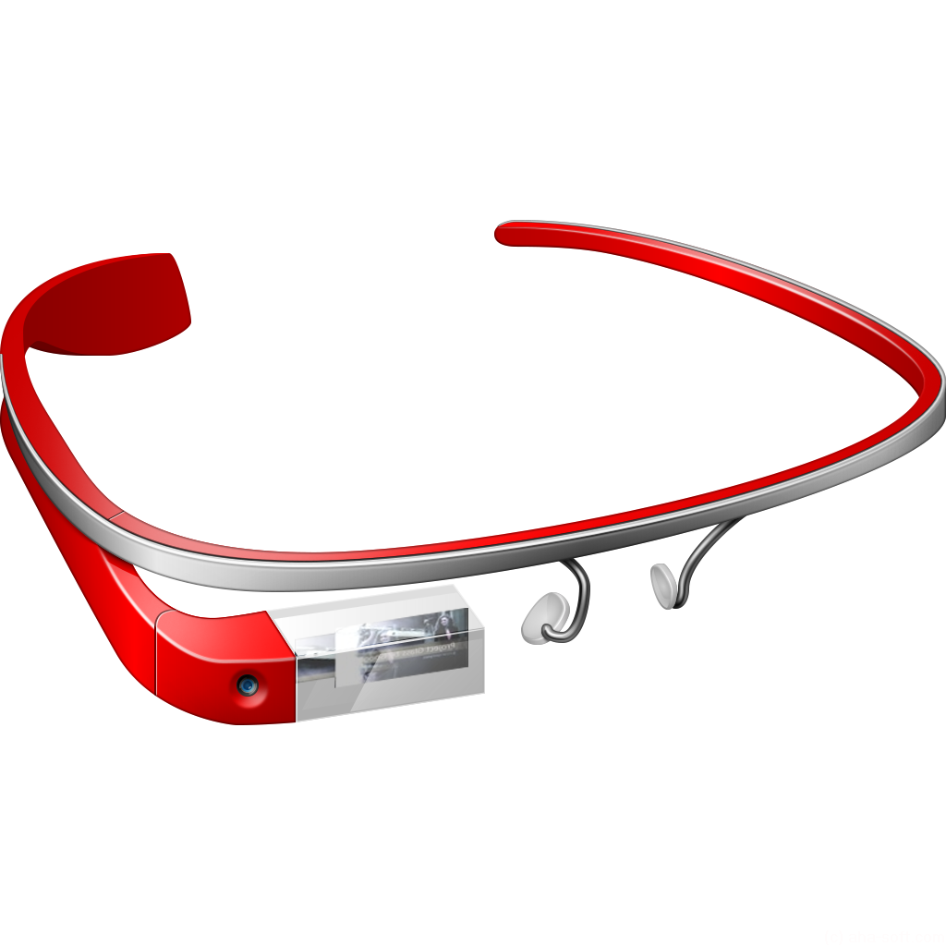
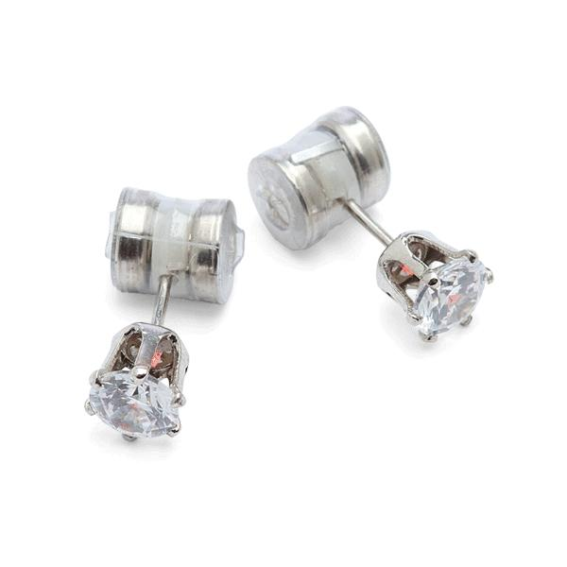

Slide 25
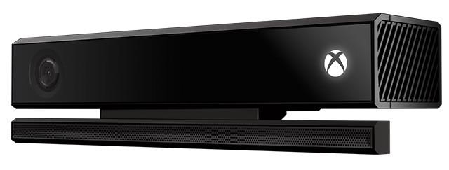
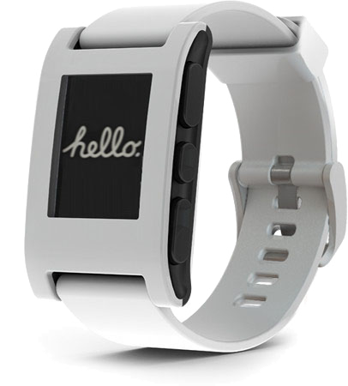
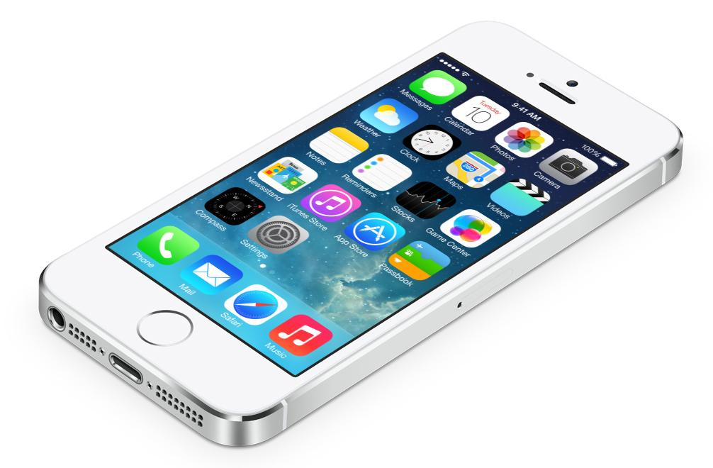
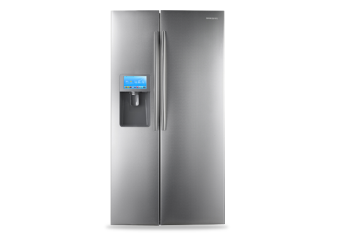

Slide 26
Hardware

Slide 27
Hardware
Software

Slide 28
Hardware
Software
Rede

Slide 29
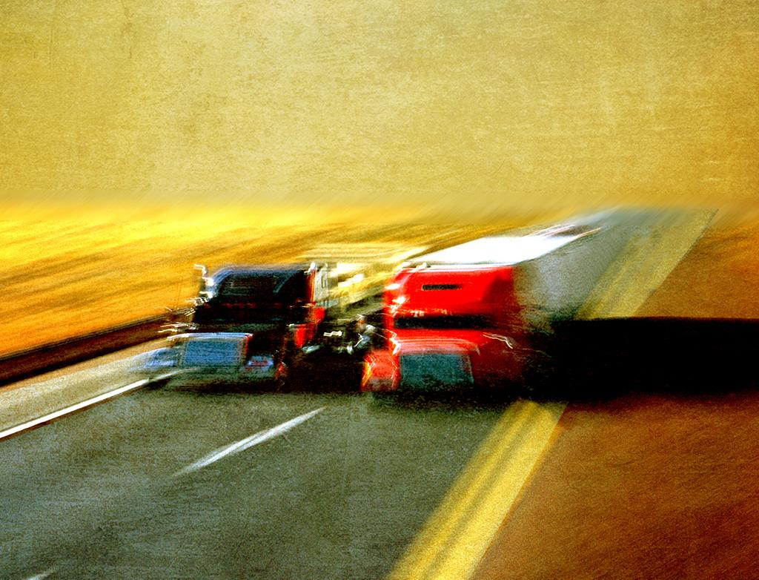
Desafios

Slide 30
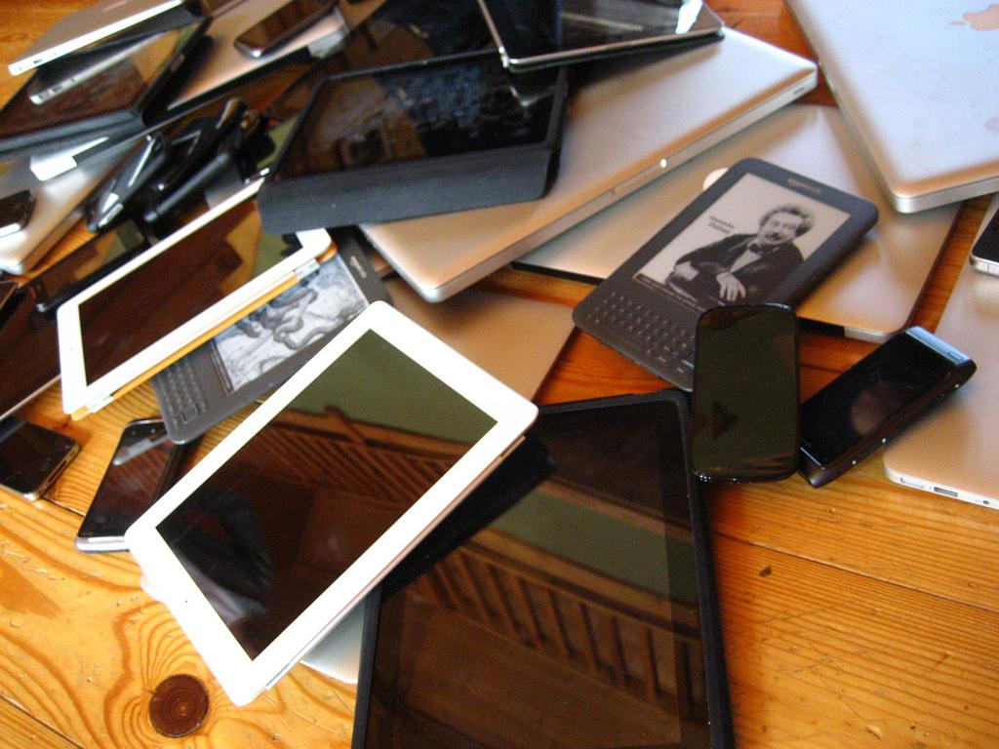
Heterogeneidade
http://www.flickr.com/photos/adactio/

Slide 31
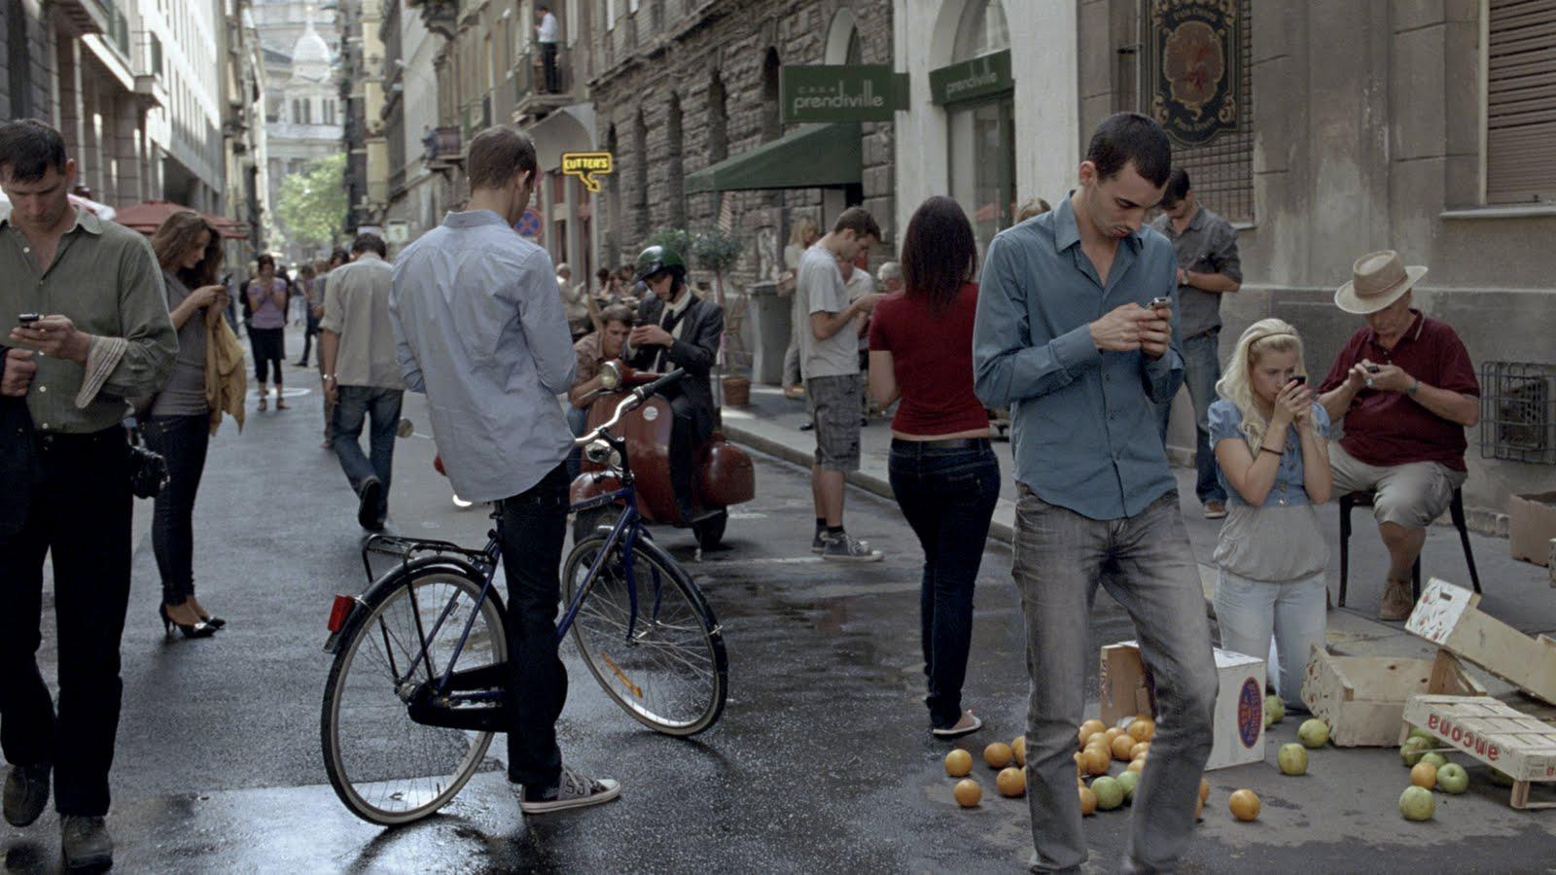
Escala

Slide 32
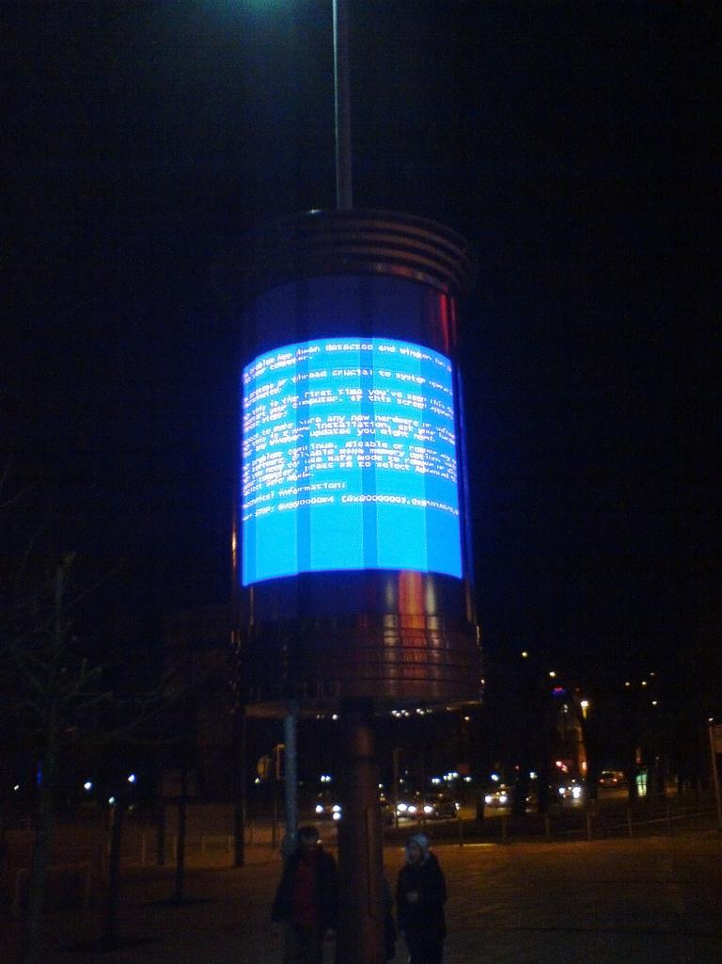
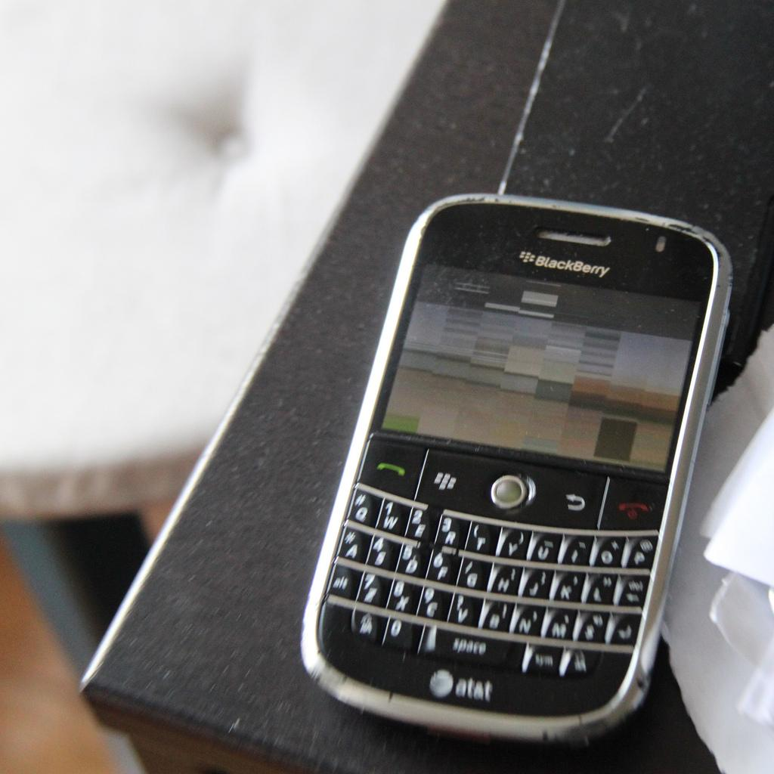
Tolerância a
Falhas
http://www.flickr.com/photos/21384462@N00/4273761578
http://www.flickr.com/photos/30775143@N00/3107606827/

Slide 33

Segurança
http://www.flickr.com/photos/27403767@N00/2443128847

Slide 34
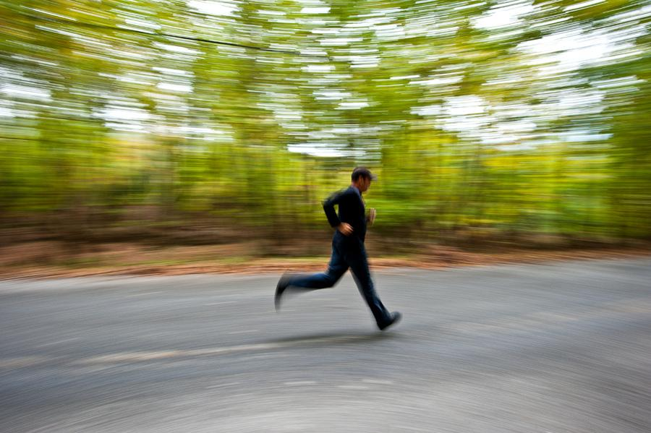
Mobilidade

Slide 35
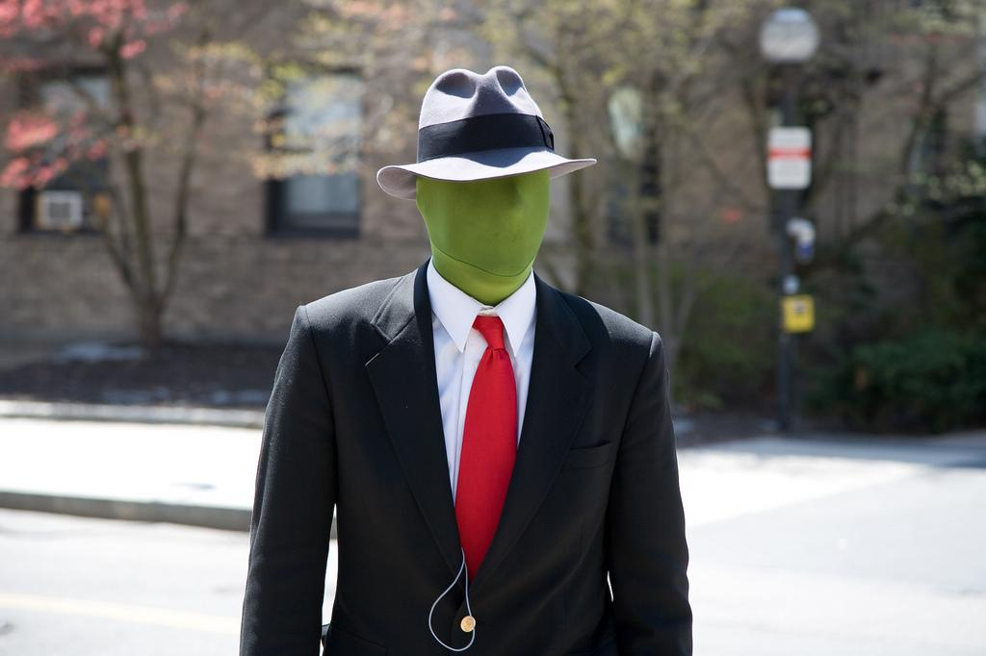
Contexto
http://www.flickr.com/photos/27403767@N00/2443128847

Slide 36
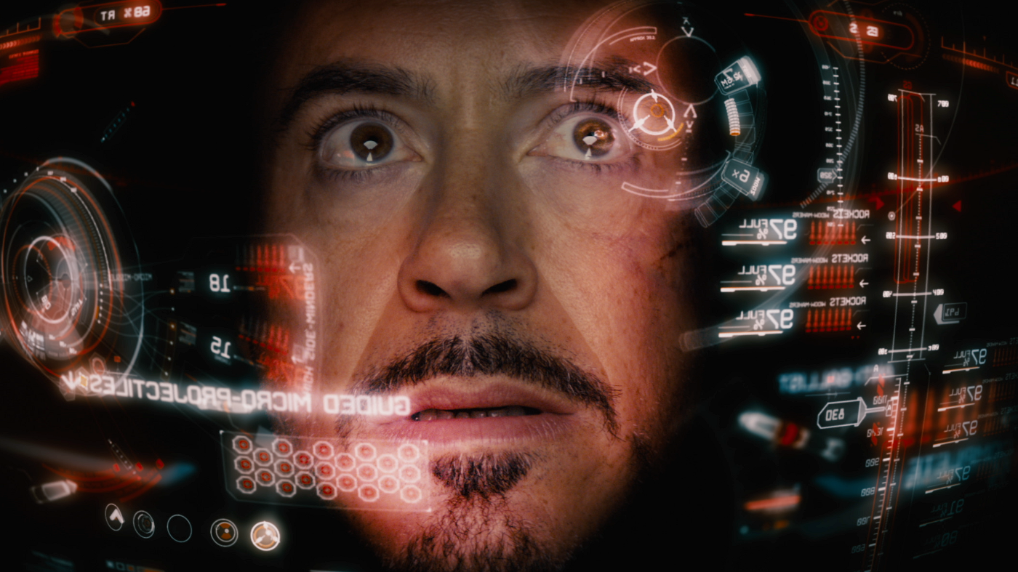
Interface

Slide 37
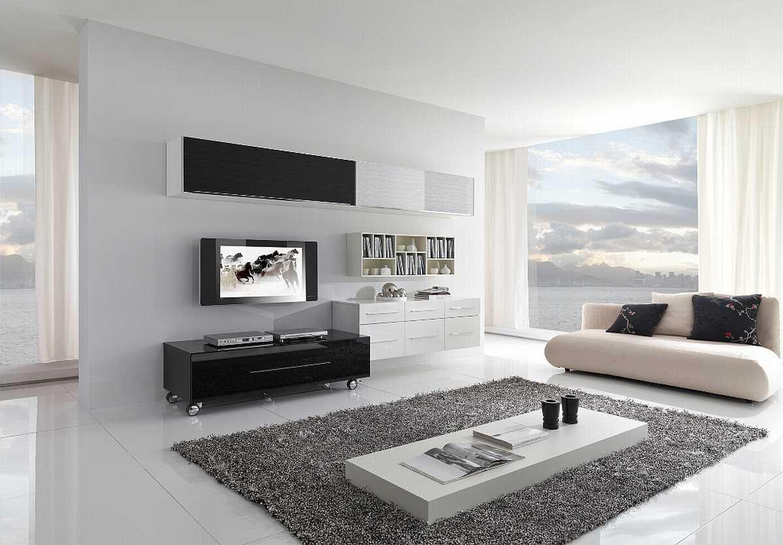
Ambiente
Inteligente

Slide 38
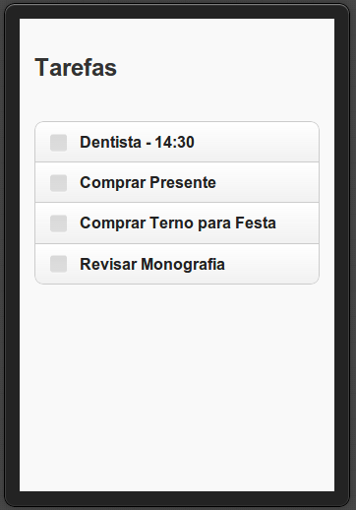

Slide 39
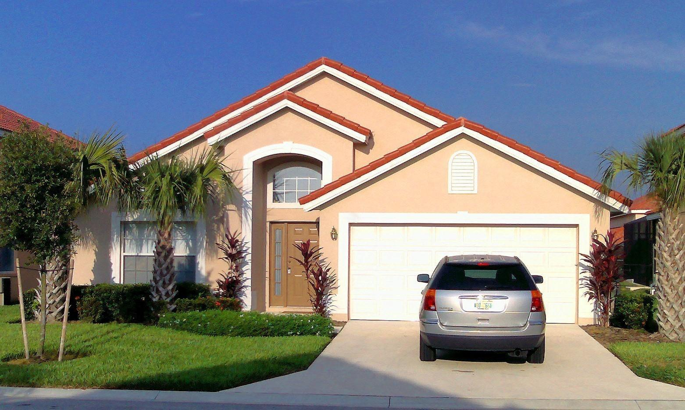
13:00

Slide 40
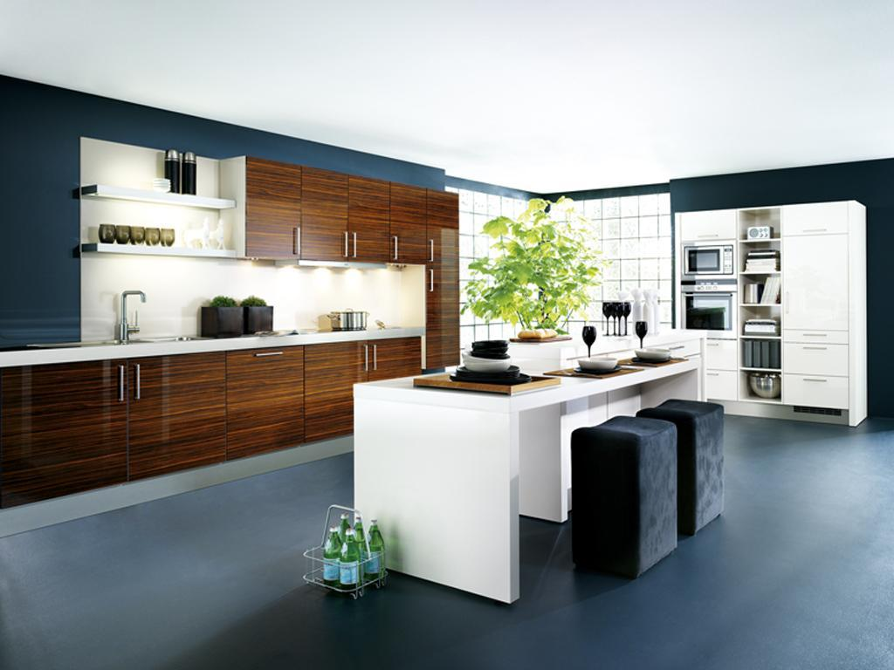

13:30

Slide 41
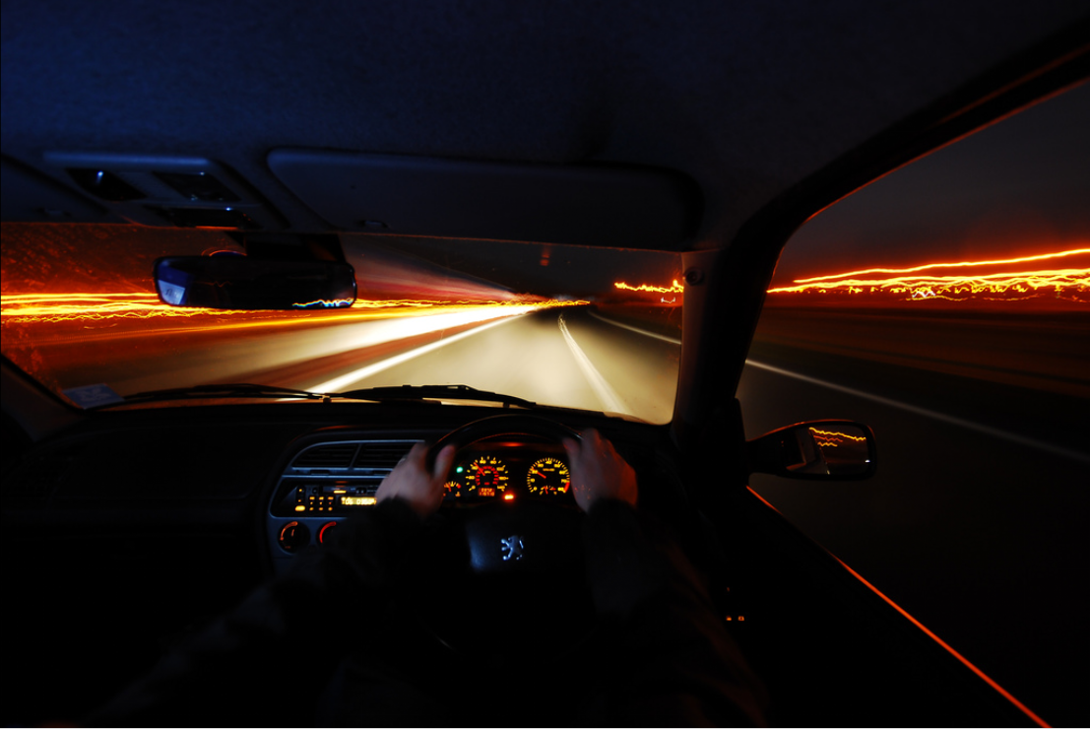
14:33

Slide 42
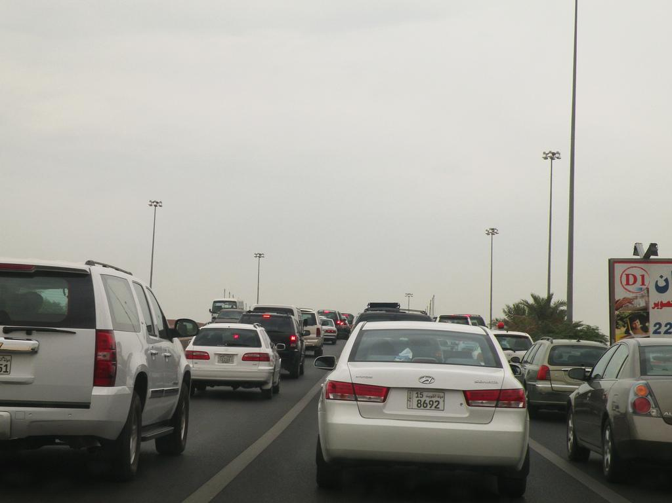
http://www.flickr.com/photos/44083360@N00/4071875074/
13:47

Slide 43
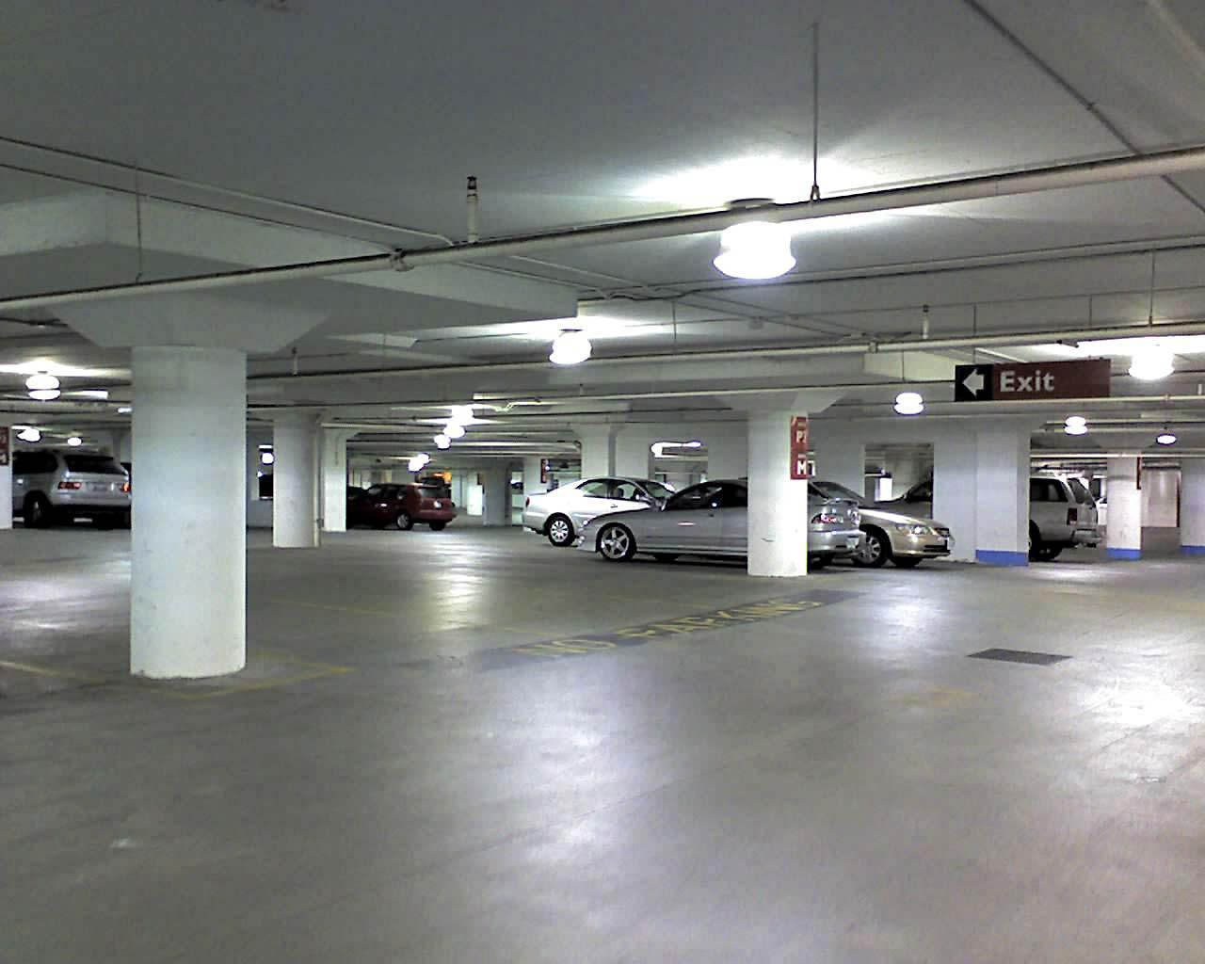
14:00

Slide 44

14:05
14:05

Slide 45
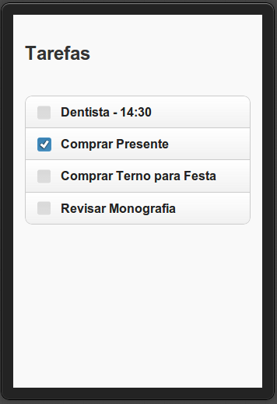

14:20

Slide 46
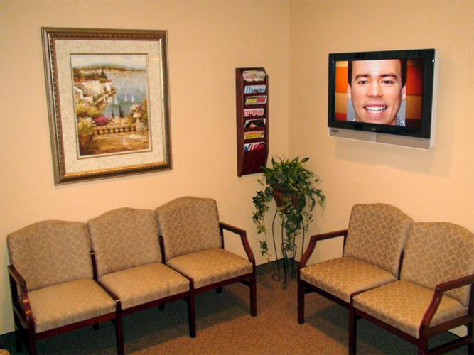
14:29

Slide 47
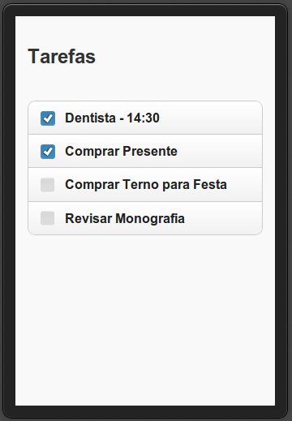
15:02
Notes:
Pensar melhor nesse exemplo

Slide 48
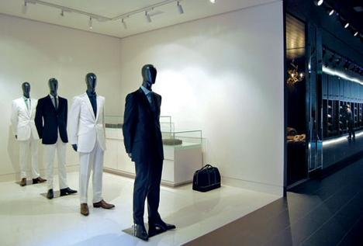
14:22

Slide 49

http://www.flickr.com/photos/wallyg/

Slide 50

http://www.flickr.com/photos/sylvain_masson/
Fabricio Nogueira
Buzeto
UbiZen Games
Tarefa
Um cenário ubíquo do seu dia a dia.

